Slide 1
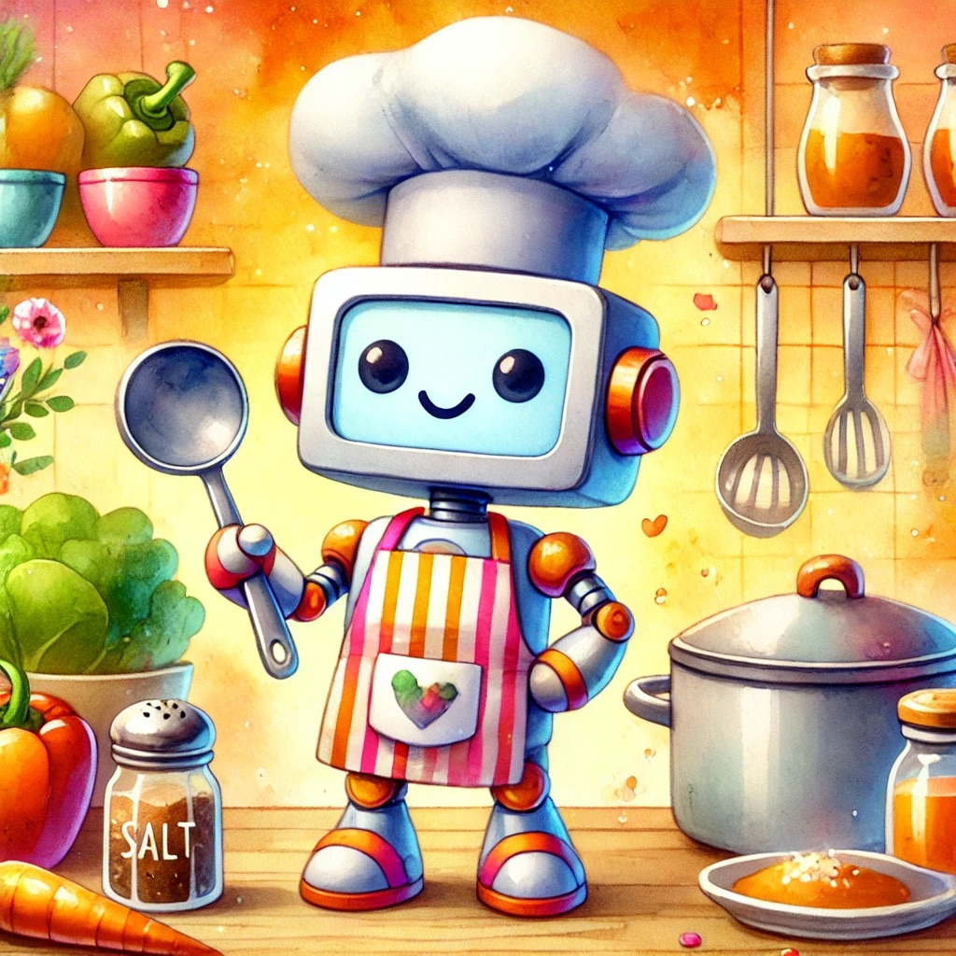

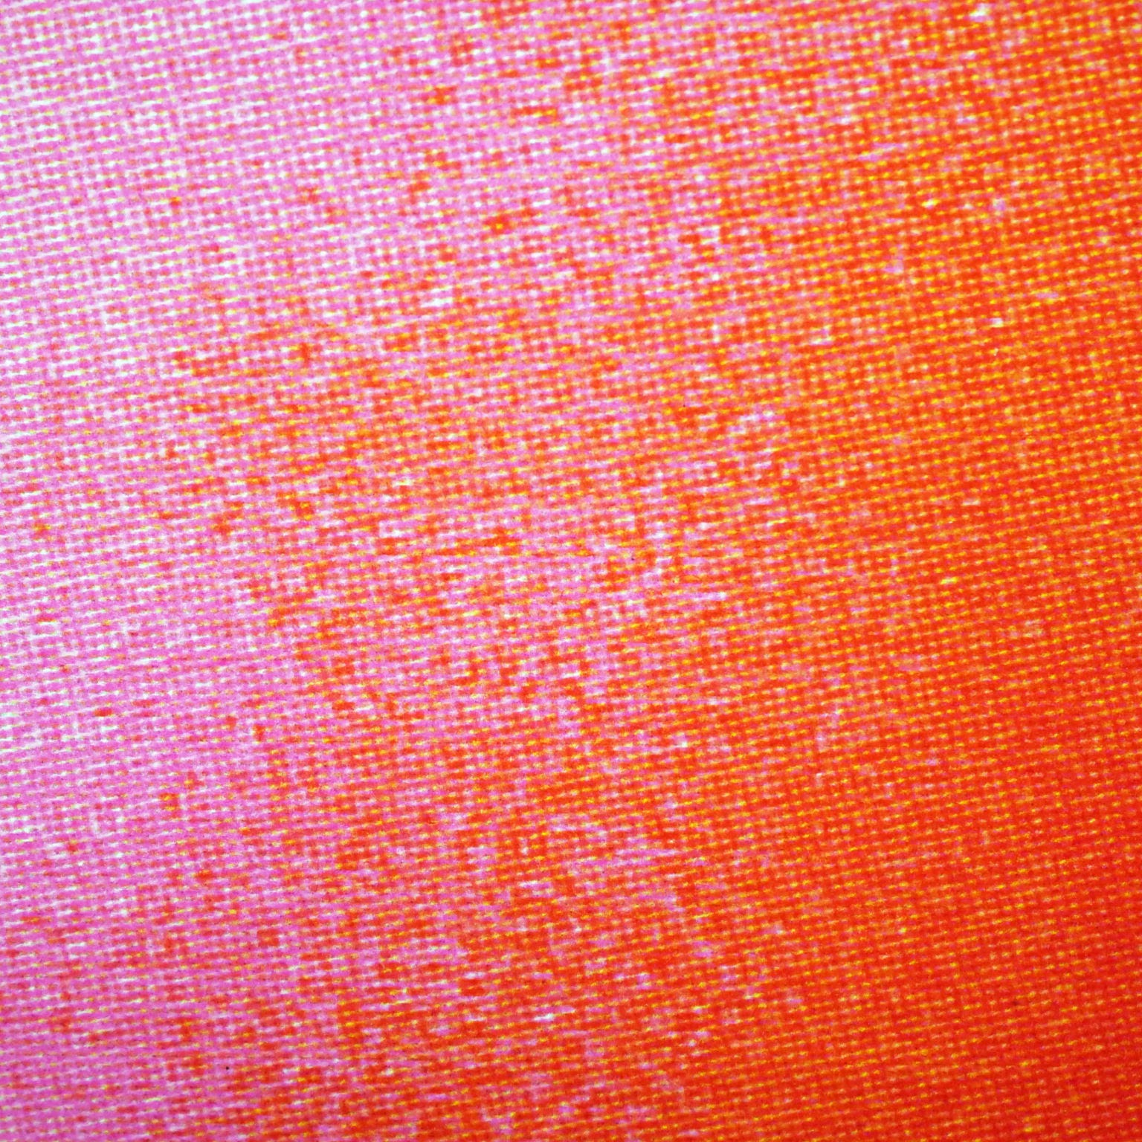
How Computers Learn Like Master Chefs
The Magic of Backpropagation!
2DEEP2LEARN

Slide 2
Chef AI
Once upon a time, in the enchanting town of Technoville, lived a unique and brilliant chef named Chef AI. Unlike other chefs, Chef AI wasn't human but a very special robot designed to make the most delicious dishes.
One bright morning, Chef AI decided to create the perfect soup, just like the one you'd find at your favorite restaurant. But there was a tiny problem – Chef AI needed some help to make it truly amazing. That's where you come in!
Magic of Backpropagation

Slide 3
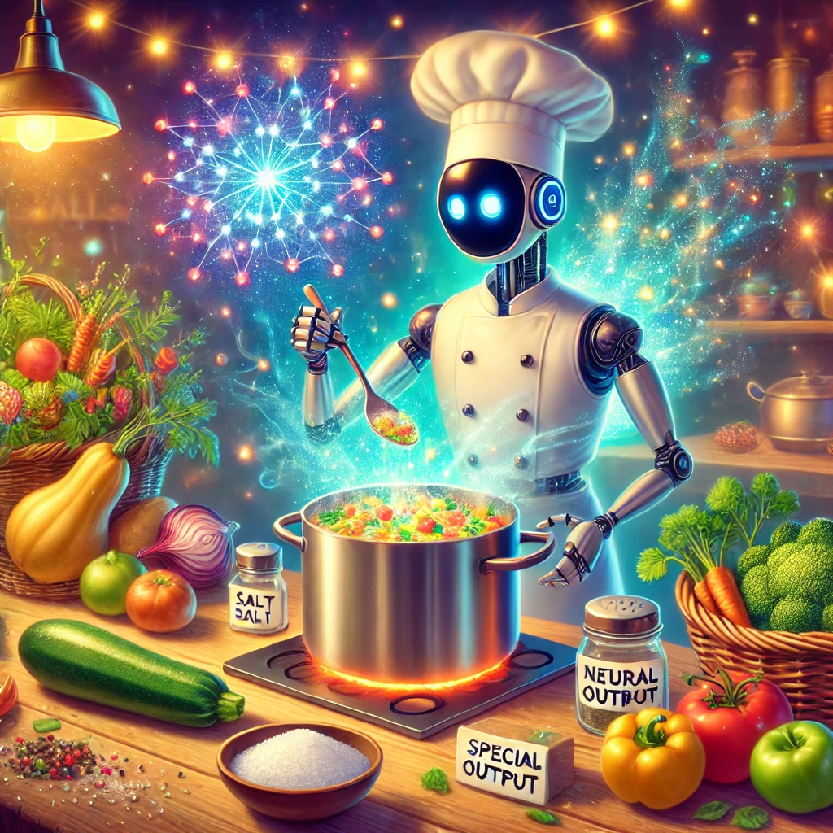
STEP 1
COOKING THE SOUP
Nerds call this a Forward Pass
Chef AI had a magical kitchen filled with the freshest ingredients: salt, crunchy carrots, squash, zucchini, and a whole array of herbs and vegetables. These ingredients were like input data; they were the building blocks of Chef AI’s culinary creations.
Using his special recipe (the secret mix of weights and biases), Chef AI combined the ingredients in his big, shiny pot. As he stirred and mixed, he made a prediction: “I predict that this bowl of soup will be delicious!” Then, he poured the soup into a special neural network output bowl. This magical bowl turned all the ingredients into a wonderful soup.

Slide 4
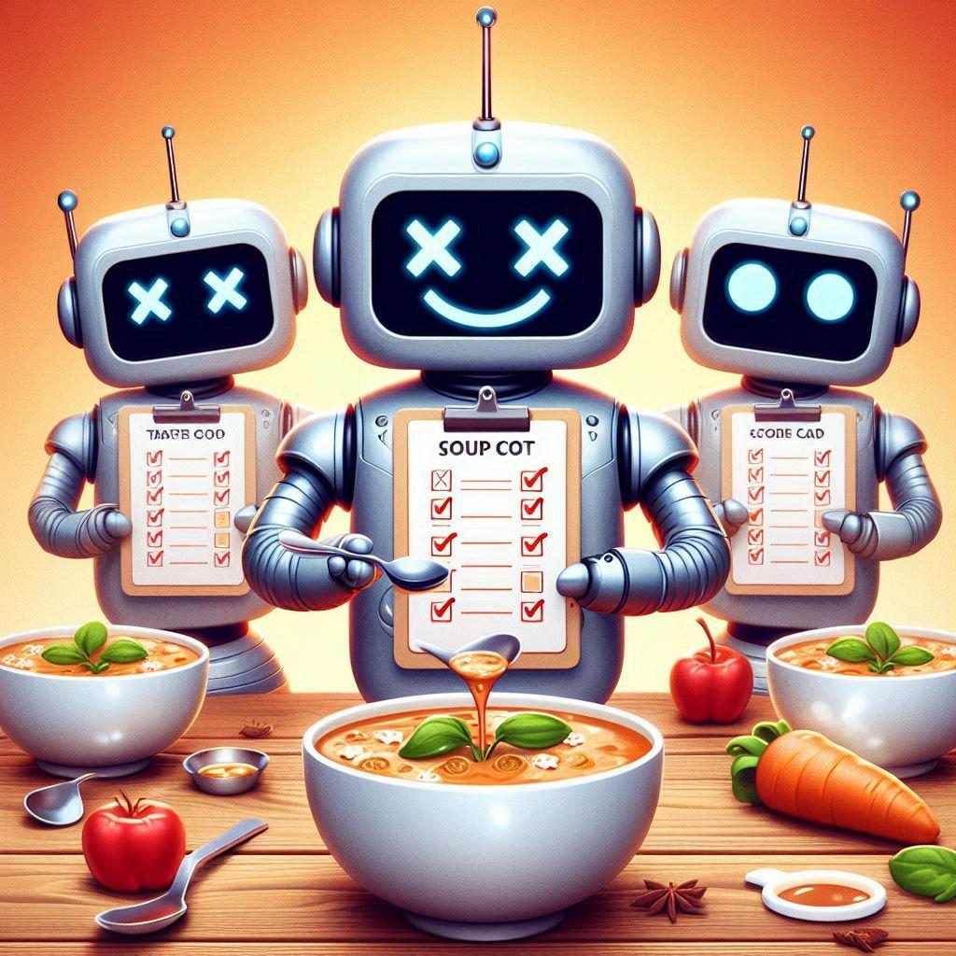
STEP 2
TASTE TESTING
Nerds call this Error Calculation
Chef AI's kitchen had a team of expert taste testers. These taste testers were professionals in error calculation. After Chef AI poured the soup into the bowl, the taste testers took a sip and compared the soup to the "perfect" soup (the target).
"This is too salty!" one taste tester exclaimed. "It needs more carrots!" another chimed in. This feedback was called error feedback.

Slide 5
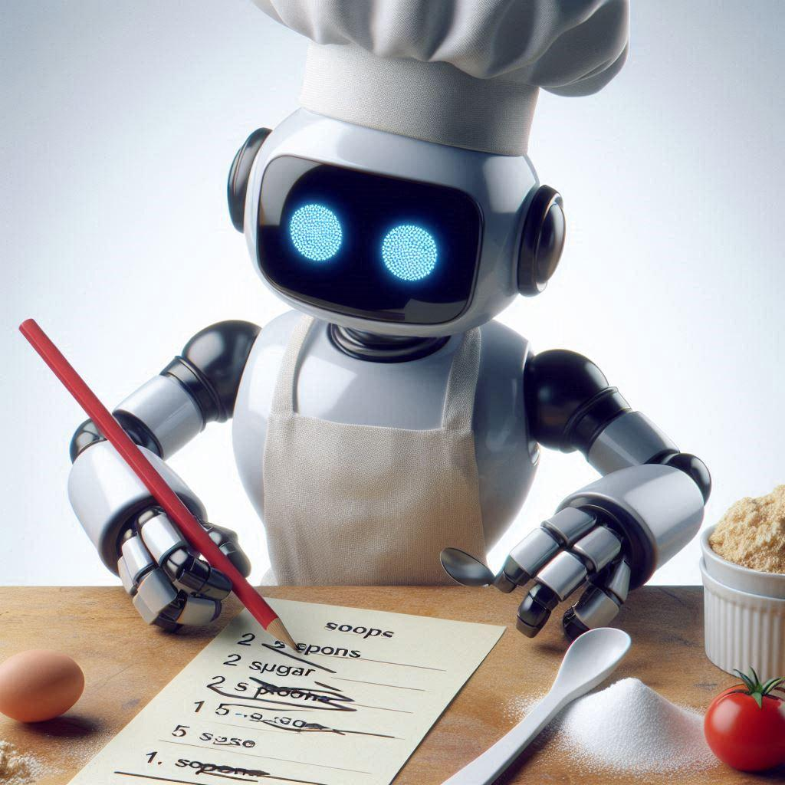
STEP 3
FIXING THE RECIPE
Nerds call this a Backward Pass
Chef AI listened carefully. He traced his steps backward to figure out which ingredient caused the imbalance. "Ah! I added too much salt. Let's adjust that."
Chef AI made tiny changes to his recipe (like adjusting the weights bit by bit – that's the learning rate), mixed the ingredients again, and poured a new bowl of soup.

Slide 6
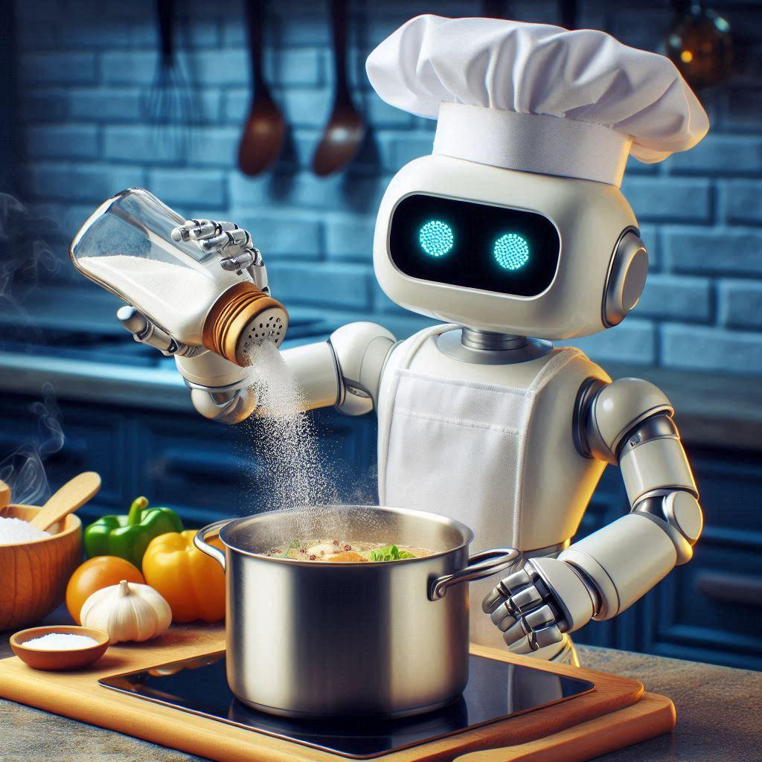
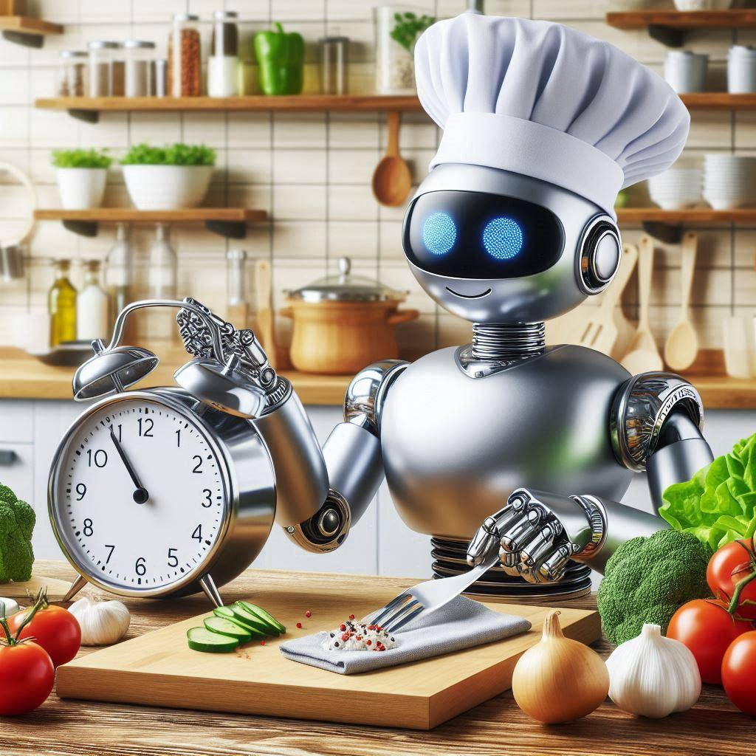
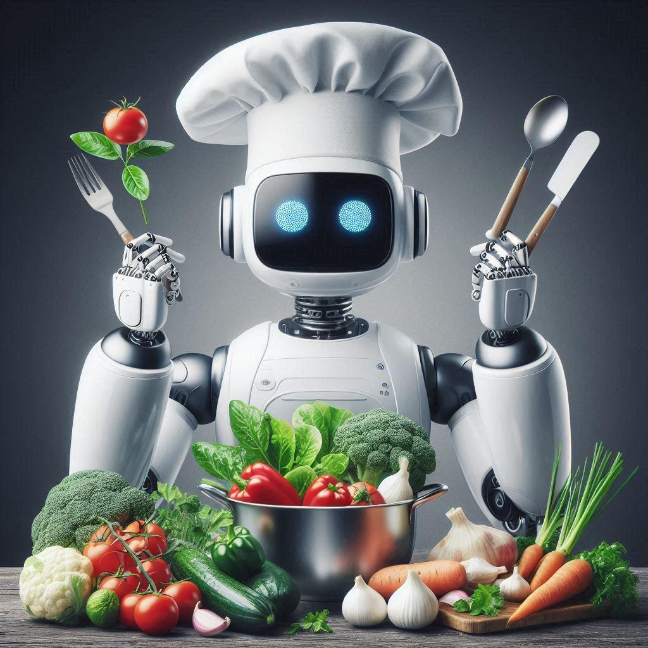
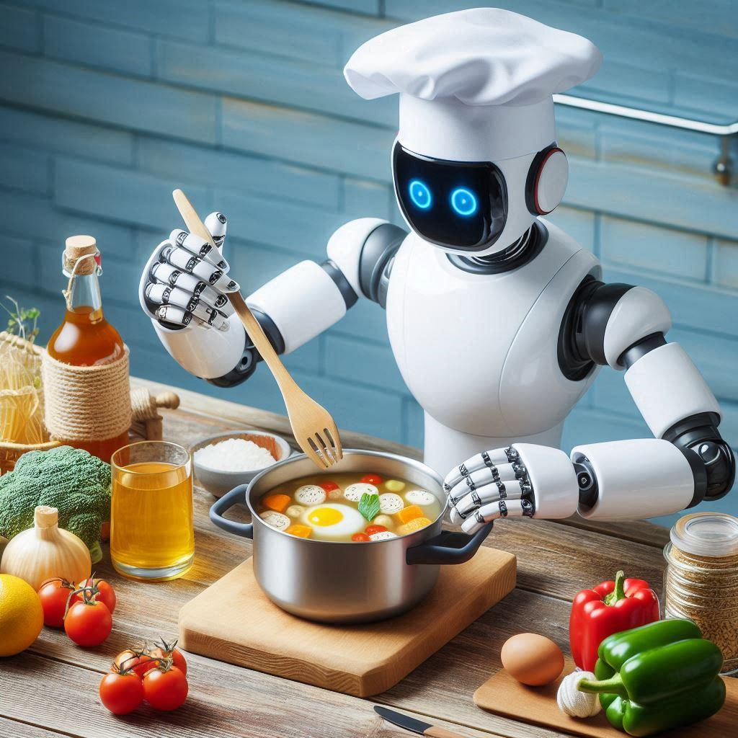
Activity: Chef AI has a dilemma! His soup came out too salty and he’s not quite sure what went wrong. Your mission is to help him figure it out. Was it too much salt? Not enough vegetables ?
With your help, Chef AI sets up a voting system to decide which ingredient or step should be adjusted. Each participant can vote on one of the following options:
Option A: Adjust the amount of salt.
Option B: Reduce baking time.
Option C: Add more vegetables.
Option D: Recheck the order of mixing ingredients.
Based on the votes, Chef AI makes the recommended changes and adjust the soup. The participants get to taste the results and see if the adjustments made a difference.

Slide 7
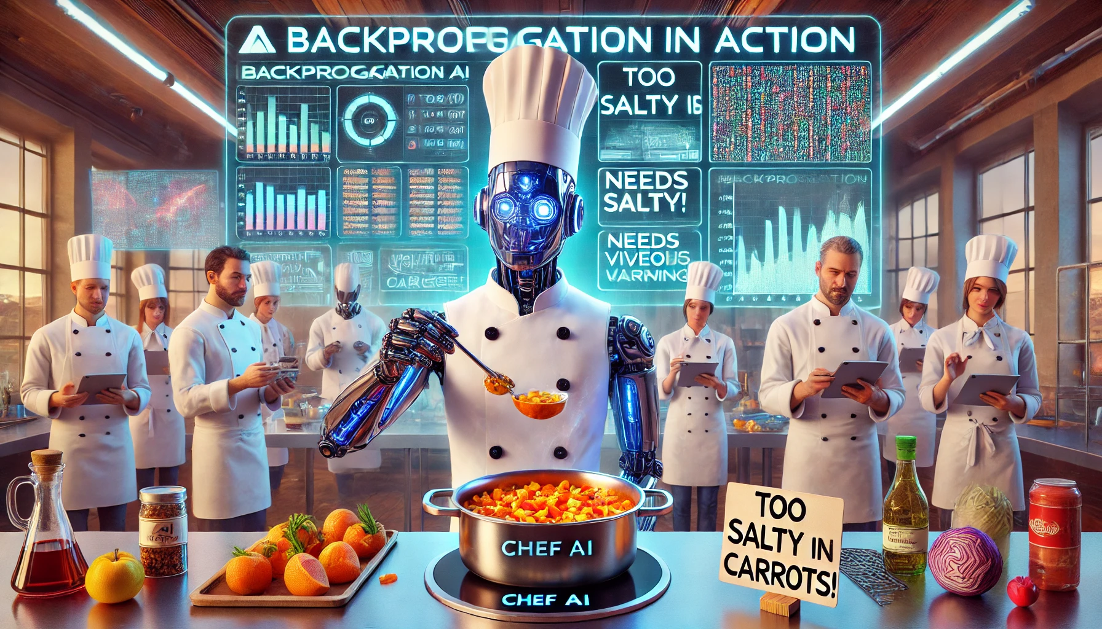
REAL-WORLD CONNECTION
Chef AI's cooking adventure isn't just about making soups a, it’s a glimpse into how AI learns and improves. Here’s a fascinating parallel:
Backpropagation: The process we used to adjust the soup recipe is similar to how AI learns from its mistakes and gets smarter every day. In the world of artificial intelligence, this process is known as backpropagation.
Imagine you’re watching YouTube, and it starts suggesting videos you’ll love based on your viewing history. Or picture a robot learning to dance, step by step, getting better with each move. That’s backpropagation in action—it helps AI fine-tune its performance by continuously adjusting based on feedback.
So, just like we tweaked our soup recipe to get perfect cookies, AI uses backpropagation to become more intelligent and effective in real-world tasks. Pretty amazing, right?

Slide 8
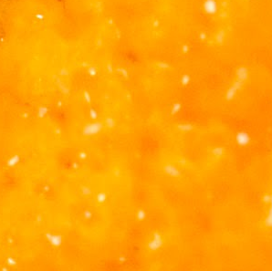
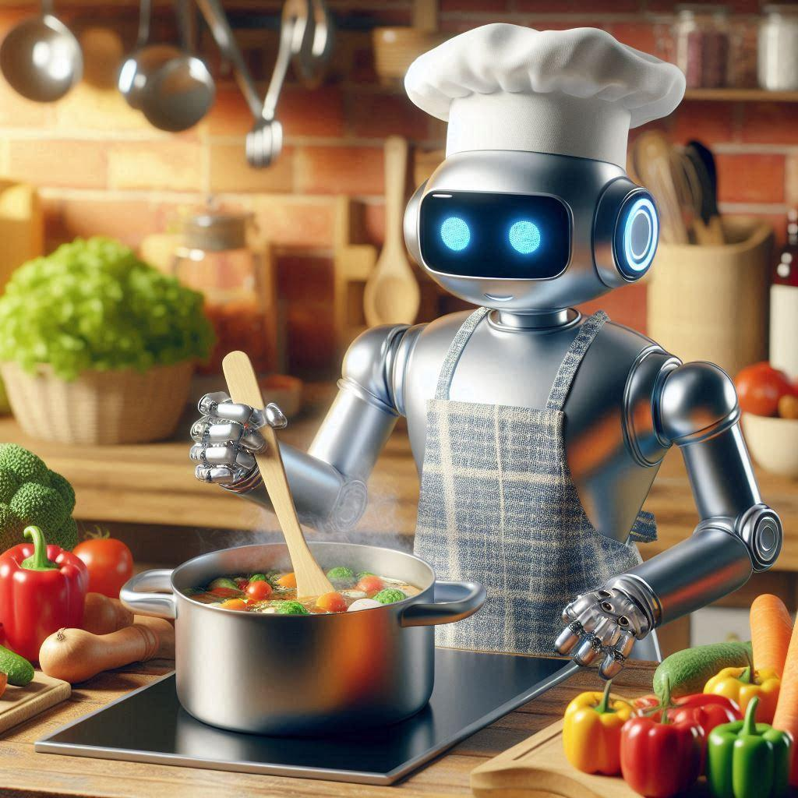
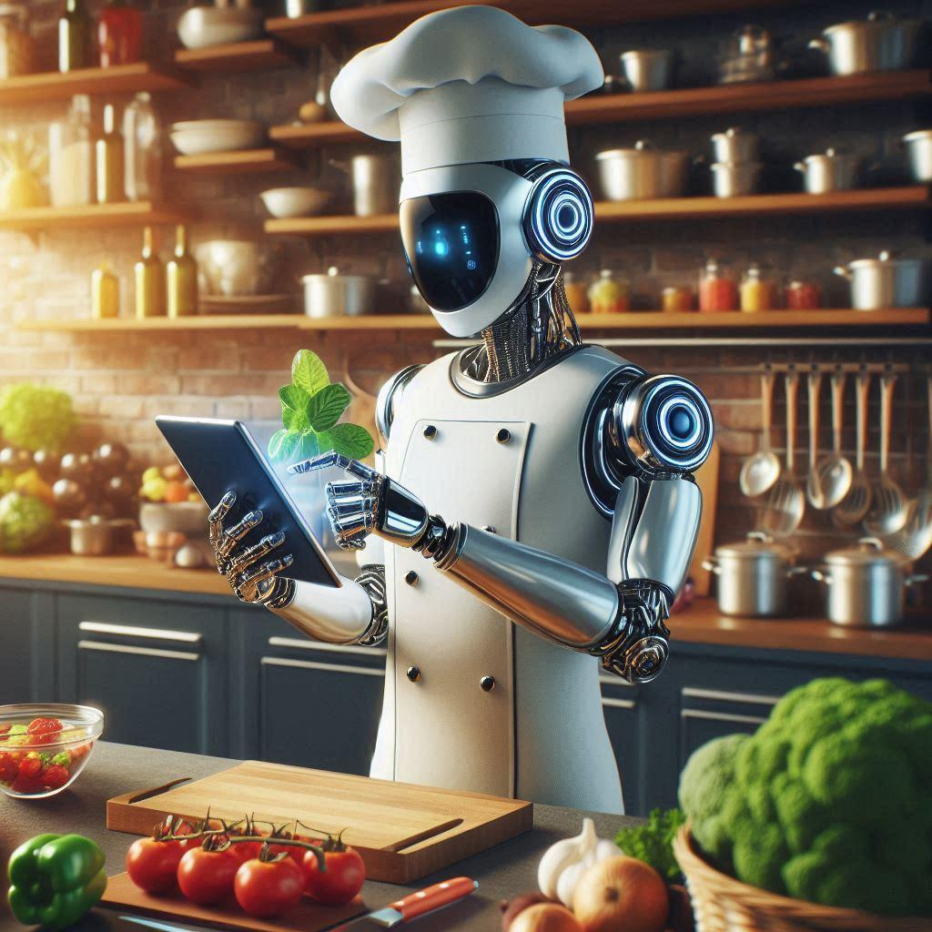
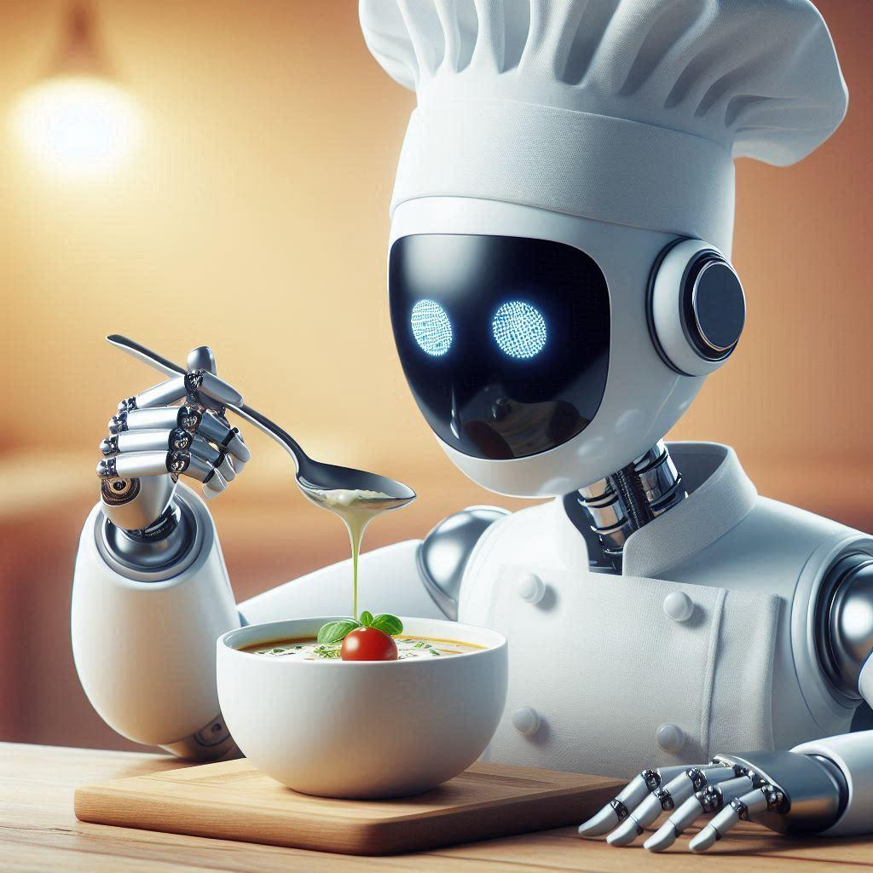
QUICK RECAP
RECAP TIME
FORWARD PASS
CALCULATE ERROR
BACKWARD PASS
Cook the soup …
Taste test …
Adjust recipe …
Quiz Question: "If Chef AI’s cake is too dry, should he add more flour or milk?"

Slide 9
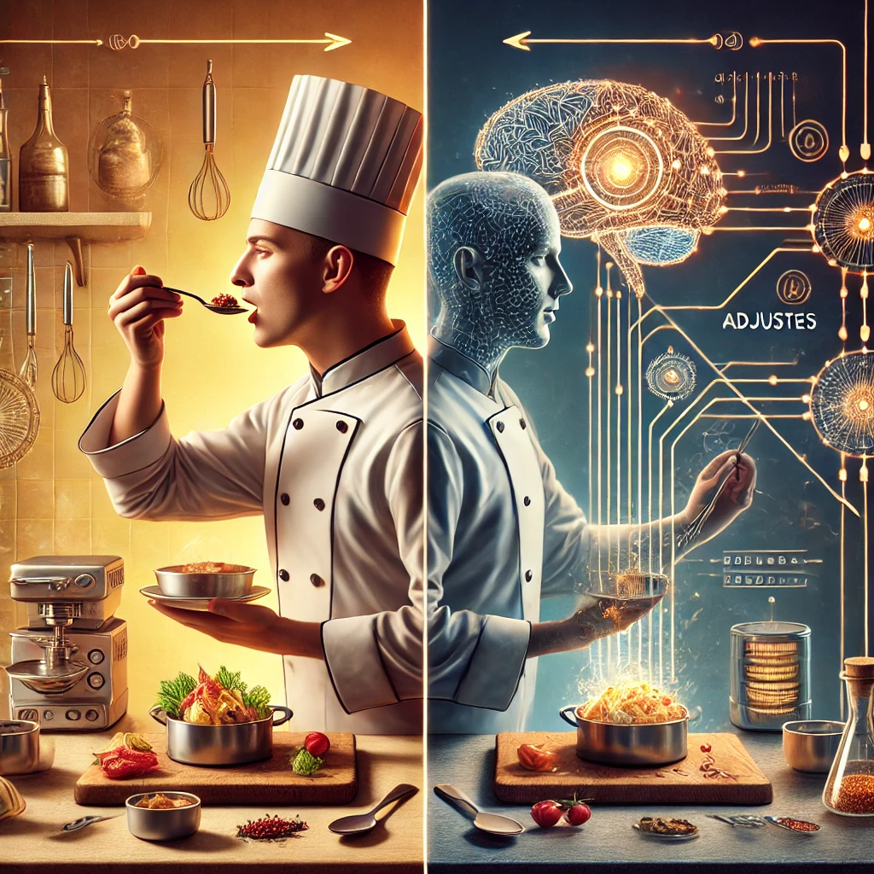

CONGRATULATIONS
CHEFS
Now YOU know how computers learn like chefs – by tasting, adjusting, and trying again!

